Slide 1

Time Series
Forecasting APPL Stock Returns Using Time Series in R
Harshita Shyam | Kanika Puri | Kao-Ying Chen

Slide 2
What is a Time Series?
Analyze data set to study the characteristics of the data and extract meaningful statistics in order to predict future values of the series.
Four methods
Time series decomposition
Forecasting
Clustering
Classification
Notes:
Times series decomposed into trend, seasonal, cyclical and irregular components
historical data is used to predict/ forecast future events
data is partitioned into groups based on similarity or distance, so that time series in the same cluster are similar to each other
classification models are built based on labeled time series and then the model is used to predict the label of unlabeled time series

Slide 3
What are the key characteristics of our Data?
Daily AAPL stock prices from Jan 2nd, 2004 - Dec 31st, 2013
Data set contains open, high, low, close and adjusted close prices
For consistency, we use adjusted close prices

Slide 4
Forecasting: ARIMA & ARMA
ARIMA:
AutoRegressive Integrated Moving Average
Calculate the autocorrelation and partial autocorrelation to obtain the input parameters and build model
ARMA:
AutoRegressive-Moving-Average models are based on two polynomial functions: AutoRegression & Moving Average
Divide the data into a training and testing dataset
Fit the model with ‘arima’ function
Plot the graph for the ARMA forecast

Slide 5
ARIMA: How does it work?
Steps to build Data Mining model
Import daily historical stock price AAPL data from Yahoo Finance
Measures: date (index) and close prices of AAPL over past 10 years
Observe Series is non-stationary by performing Augmented Dickey-Fuller Test
ARIMA input params: p,d,q
Use logged time series and input parameters for ARIMA to fit ARIMA model and forecast AAPL stock

Slide 6
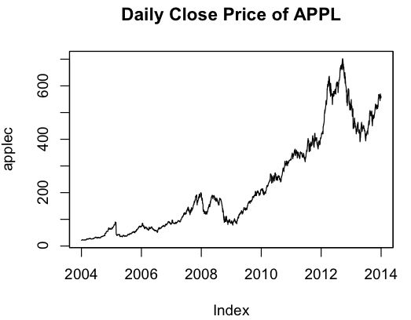
AAPL Daily Historical Close Price Stock 2004-2013
Notes:
-stationary

Slide 7
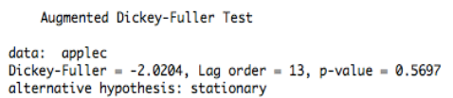
Ensuring Non-Stationary Series : Augmented Dickey-Fuller Test
If Series is
Stationary? We skip Differencing and Plotting
Not Stationary? We Difference and Plot data to make it stationary
Our Series is confirmed non-stationary since alternative hypothesis is stationary
Notes:
Reason to convert: Statistical properties remain the same for the future as they have in the past

Slide 8
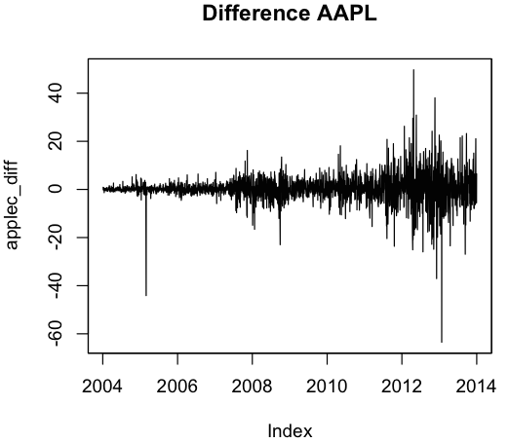
Exponential Growth 04-13
Differences of AAPL Prices
Notes:
The graph on the left is the original time series of Apple stock price from 01/02/2004 to 12/31/2013, showing exponential growth while the graph on the right, shows the differenced of apple stock prices. It can be seen that the variance of the series increases as the level of original series increases, and therefore, it is not stationary.
Transformations such as logarithms can help to stabilize the variance of a time series. Differencing can help stabilize the mean of a time series by removing changes in the level of a time series, and so eliminating trend and seasonality.
Diffrencing - to make the mean, variance and autocorrelation stationary

Slide 9
Plot of Differenced and Non-Stationary Series
It can be seen that the variance of the series increases as the level of original series increases, and therefore, it is not stationary.
Log of Plots:
Take log of Original Series and Plot Log Price
Take log of Difference Series and Plot Log Price

Slide 10
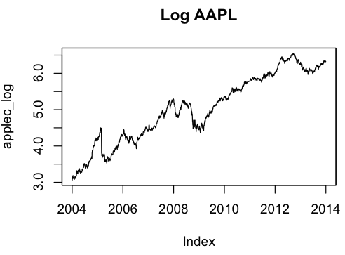
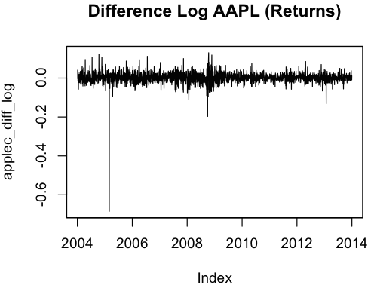
Linearized Series of Original AAPL Close Prices
Centers Around Mean with Low Variance
Notes:
The graph on the left shows the log price of Apple. The series is more linear compared to the original one while the graph on the right shows the differences of log price of Apple. The series seems more mean- reverting, and variance is constant and does not significantly change as level of original series changes.

Slide 11
ARIMA Model Inputs & Accuracy
As seen in the next slide, both ACF models show consistency in lags in Series
PACF models show inconsistency in lags in Series
Suggests presence of white noise
Alternatives
AIC (Akaike Information Criterion) : tests using various p & q values
RMSE value indicates accuracy: 0.2268 (the lower, the better)

Slide 12
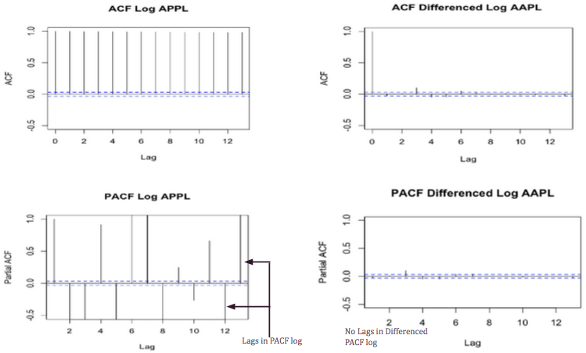
Logs of ACF and PACF

Slide 13
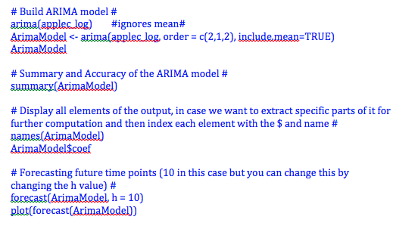
ARIMA model and its Accuracy

Slide 14
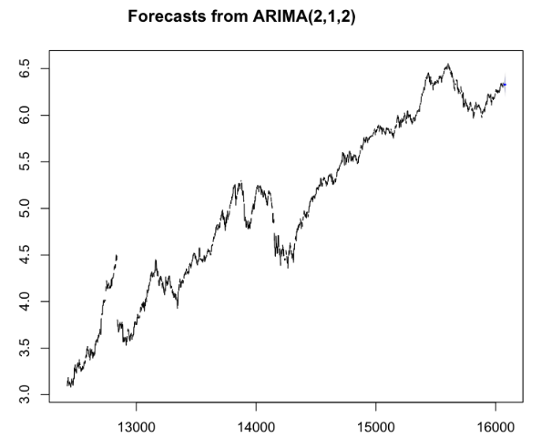
Notes:
The time series is stationary and the rather small interval (shaded region) around the points estimate (h = 10) is reasonable given the small fluctuations of the existing series

Slide 15
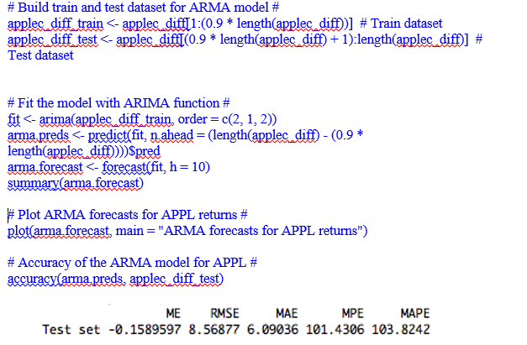
ARMA model and its Accuracy
Notes:
root mean square error
p, q param from arima and forcast results

Slide 16
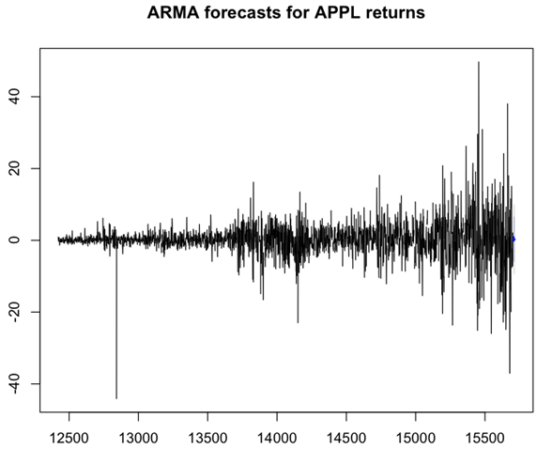
Notes:
Assume mean reversion (over a long period of time, it takes the average stock prices) & over time price of the stock
linear and stationary

Slide 17
Comparison between models: ARMA & ARIMA
ARMA:
95% and 99% Confidence Interval for forecasts
Assumes mean reversion
Poor Model for Long Term Predictions
Lower Accuracy, Higher RMSE (8.56)
ARIMA:
80% and 95% Confidence Interval for forecasts
Good Model for Long Term Predictions
Higher Accuracy, Lower RMSE (0.022)
Verdict: ARIMA is a better model
Notes:
RMSE- root mean square error
Reversion - calculates average stock price for longer prediction periods
Arima is a good model because it stabalizes mean and variance
and time series remains station over longer prediction periods
and doesn’t assume average stock prices like the arma model

Slide 18
Thank You!

